Slide 1
DATA STRUCTURE & ALGORITHMS
LINKED LIST

Slide 2
DEFINITION - LIST
A list is a collection of items that has a particular order
  It can have an arbitrary length
  Objects / elements can be inserted or removed at arbitrary locations in the list
  A list can be traversed in order one item at a time

Slide 3
LIST OVERVIEW
Linked lists
  Abstract data type (ADT)
Basic operations of linked lists
  Insert, find, delete, print, etc.
Variations of linked lists
  Singly linked lists
  Circular linked lists
  Doubly linked lists
  Circular doubly linked list

Slide 4
OPERATION ON LINKED LIST
The primitive operations performed on the linked list are as follows
1. Creation
2. Insertion
3. Deletion
4. Traversing
5. Searching
6. Concatenation

Slide 5
OPERATION ON LINKED LIST
The primitive operations performed on the linked list are as follows
1. CREATION operation is used to create a linked list. Once a linked list is created with one node, insertion operation can be used to add more elements in a node.
2. Insertion
3. Deletion
4. Traversing
5. Searching
6. Concatenation

Slide 6
OPERATION ON LINKED LIST
The primitive operations performed on the linked list are as follows
1. Creation
2. INSERTION operation is used to insert a new node at any specified location in the linked list. A new node may be inserted.
  (a) At the beginning of the linked list
  (b) At the end of the linked list
  (c) At any specified position in between in a linked list
3. Deletion
4. Traversing
5. Searching
6. Concatenation

Slide 7
OPERATION ON LINKED LIST
The primitive operations performed on the linked list are as follows
1. Creation
2. Insertion
3. DELETION operation is used to delete an item (or node) from the linked list. A node may be deleted from the
(a) Beginning of a linked list
(b) End of a linked list
(c) Specified location of the linked list
4. Traversing
5. Searching
6. Concatenation

Slide 8
OPERATION ON LINKED LIST
The primitive operations performed on the linked list are as follows
1. Creation
2. Insertion
3. Deletion
4. TRAVERSING is the process of going through all the nodes from one end to another end of a linked list.
5. Searching
6. Concatenation

Slide 9
OPERATION ON LINKED LIST
The primitive operations performed on the linked list are as follows
1. Creation
2. Insertion
3. Deletion
4. Traversing
5. Searching
6. CONCATENATION is the process of appending the second list to the end of the first list.

Slide 10
Linked List Terminologies
Traversal of List
  Means to visit every element or node in the list beginning from first to last.
Predecessor and Successor
  In the list of elements, for any location n, (n-1) is predecessor and (n+1) is successor.
  In other words, for any location n in the list, the left element is predecessor and the right element is successor.
  Also, the first element does not have predecessor and the last element does not have successor.

Slide 11
LINKED LISTS
A linked list is a series of connected nodes
Each node contains at least
  A piece of data (any type)
  Pointer to the next node in the list (link)
Head: pointer to the first node
The last node points to NULL
node
A
data
pointer
A
B
C
∅
Head

Slide 12
LINKED LIST (CONT.)
The data item fields hold the information content or data to be represented by the node.
The link fields holds the addresses of the neighbouring nodes or of those nodes which are associated with the given node as dictated by the application.

Slide 13
The NULL pointer
NULL is a special pointer value that does not reference any memory cell.
If a pointer is not currently in use, it should be set to NULL so that one can determine that it is not pointing to a valid address:
int *p;
p = NULL;

Slide 14
LINKED LIST (CONT.)
A NULL acts as a sentinel or flag to indicate when the last structure has been processed
In addition to an end-of-list sentinel value, we must provide a special pointer for storing the address of the first structure in the list

Slide 15
LISTS – ANOTHER PERSPECTIVE
A list is a linear collection of varying length of homogeneous components.
Homogeneous: All components are of the same type.
Linear: Components are ordered in a line (hence called Linear linked lists).
Arrays are lists..

Slide 16
ARRAYS VS LISTS
Arrays are lists that have a fixed size in memory.
The programmer must keep track of the length of the array
No matter how many elements of the array are used in a program, the array has the same amount of allocated space.
Array elements are stored in successive memory locations. Also, order of elements stored in array is same logically and physically.

Slide 17
ARRAYS VS LISTS
A linked list takes up only as much space in memory as is needed for the length of the list.
The list expands or contracts as you add or delete elements.
In linked list the elements are not stored in successive memory location
Elements can be added to (or deleted from) either end, or added to (or deleted from)the middle of the list.

Slide 18
ARRAYS VS LISTS
Linked lists are more complex to code and manage than arrays, but they have some distinct advantages.
  Dynamic: a linked list can easily grow and shrink in size.
    We don’t need to know how many nodes will be in the list. They are created in memory as needed.
    In contrast, the size of a C++ array is fixed at compilation time.
  Easy and fast insertions and deletions
    To insert or delete an element in an array, we need to copy to temporary variables to make room for new elements or close the gap caused by deleted elements.
    With a linked list, no need to move other nodes. Only need to reset some pointers.

Slide 19
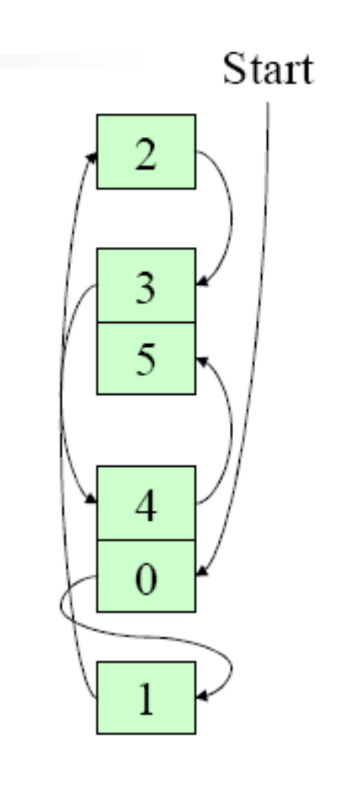
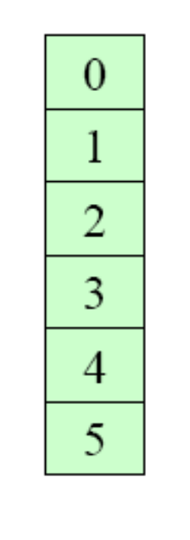
An Array
A Linked List

Slide 20
BASIC OPERATIONS OF LINKED LIST
Operations of Linked List
  IsEmpty: determine whether or not the list is empty
  InsertNode: insert a new node at a particular position
  FindNode: find a node with a given value
  DeleteNode: delete a node with a given value
  DisplayList: print all the nodes in the list

Slide 21
LINKED LIST (CONT.)
Irrespective of the number of data item fields, a linked list is categorized as
  Singly linked list
  Doubly linked list
  Circularly linked list
  Multiply linked list

Slide 22

REPRESENTATION OF LINKED LIST
Linked list representation of integers

Slide 23
LINKED LIST HAVE MANY ADVANTAGES AND SOME OF THEM ARE:
1. Linked list are dynamic data structure. That is, they can grow or shrink during the execution of a program.
2. Efficient memory utilization
3. Insertion and deletion are easier and efficient. Linked list provides flexibility in inserting a data item at a specified position and deletion of a data item from the given position.
4. Many complex applications can be easily carried out with linked list.

Slide 24
LINKED LIST HAS FOLLOWING DISADVANTAGES
1. More memory: to store an integer number, a node with integer data and address field is allocated. That is more memory space is needed.
2. Access to an arbitrary data item is little bit cumbersome and also time consuming.

Slide 25
SINGLY LINKED LIST
A singly linked list is a linear data structure, each node of which has one or more data item fields (DATA) but only a single link field (LINK).

Slide 26



Slide 27


Slide 28
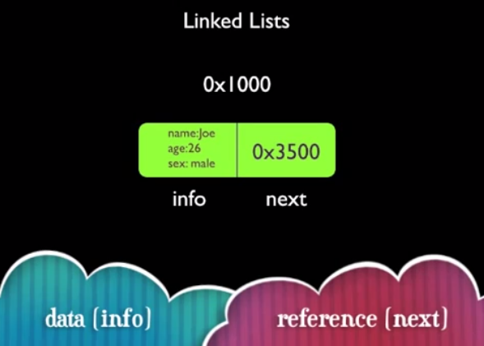

Slide 29


Slide 30
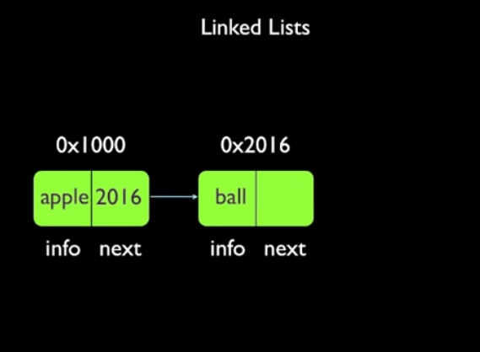

Slide 31
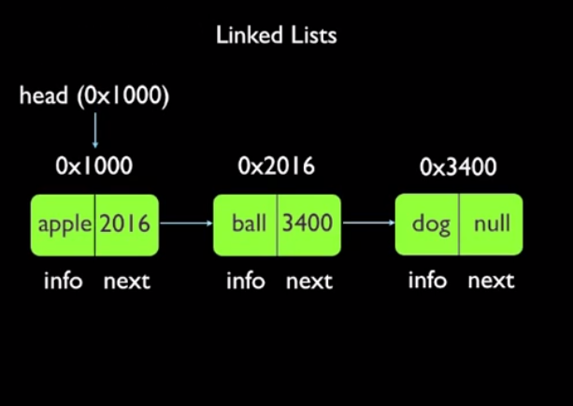

Slide 32
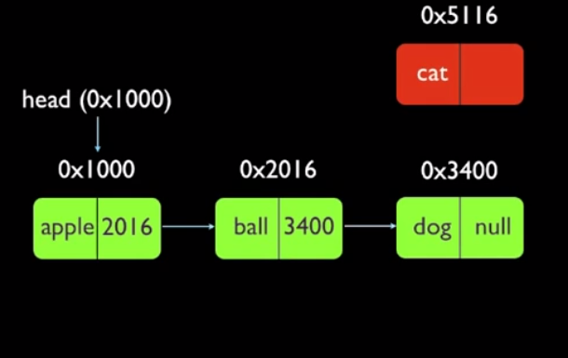

Slide 33
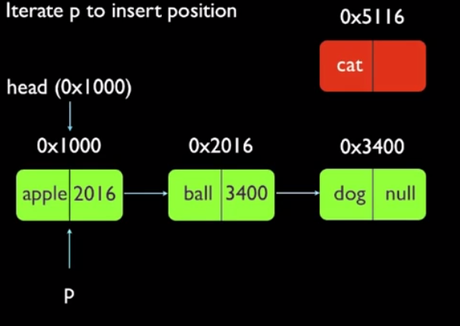

Slide 34
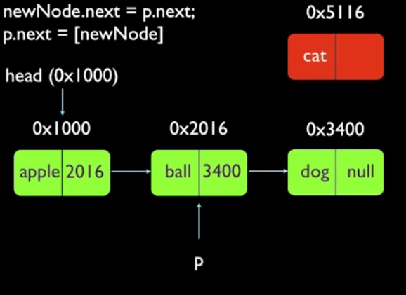

Slide 35
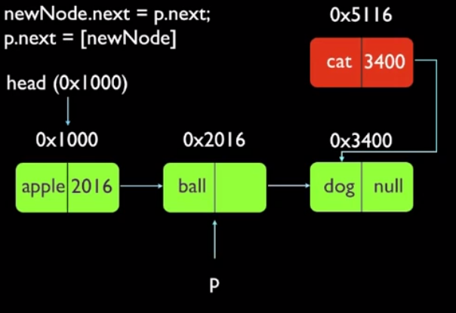

Slide 36
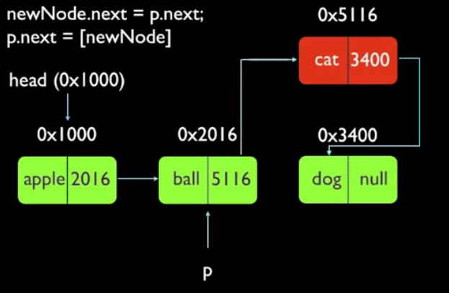

Slide 37
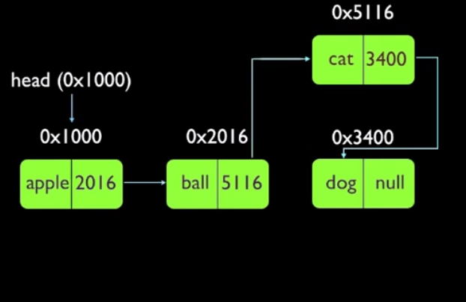

Slide 38
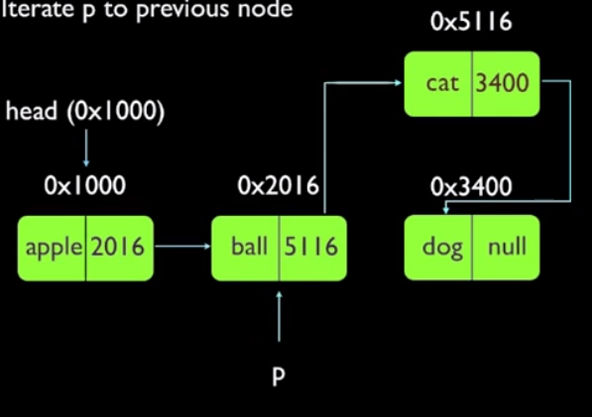

Slide 39
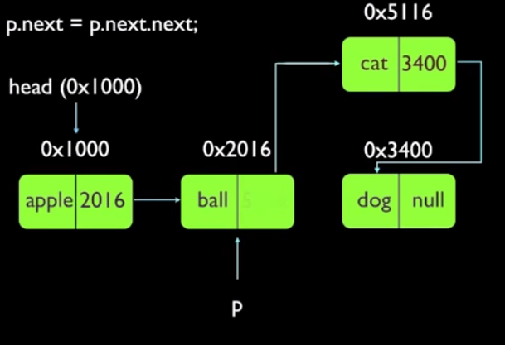

Slide 40
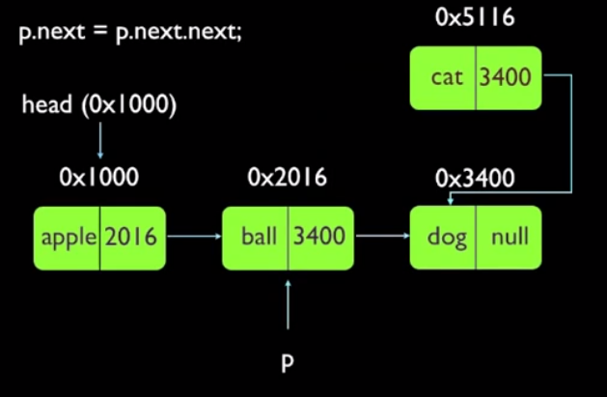

Slide 41
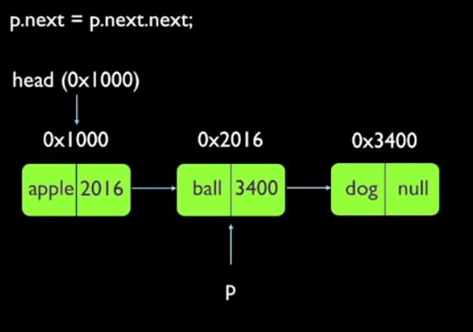

Slide 42
AN INTEGER LINKED LIST
First Node of List
Last Node of List
list
10
13
5
2
data
next
NULL

Slide 43
Creating a List node
struct Node {
int data; // data in node
Node *next; // Pointer to next node
};
Node *p;
p = new Node;
p - > data = 10;
p - > next = NULL;
p
10

Slide 44
Adding a node to a list
Node *p, *q;
p = new Node;
p - > data = 10;
p - > next = NULL;
q = new Node;
q - > data = 6;
q - > next = NULL;
p - > next = q;
p
10
q
6
10
6
p
q

Slide 45
Accessing List Data
Node 1
Node 2
p
10
6
Expression
p
p - > data
p - > next
p - > next - > data
p - > next - > next
Value
Pointer to first node (head)
10
Pointer to next node
6
NULL pointer

Slide 46
Using typedef with pointers
struct Node {
int data; // data in node
Node *next; // Pointer to next node
};
typedef Node *NodePtr; // NodePtr type is a pointer
// to a Node
Node *p; // p is a pointer to a Node
NodePtr q; // q is a pointer to a Node

Slide 47
Building a list from 1 to n
struct Node {
int data;
Node *next;
};
Node *head = NULL; // pointer to the list head
Node *lastNodePtr = NULL; // pointer to last node in list
head
lastNodePtr

Slide 48
Creating the first node
Node *ptr; // declare a pointer to Node
ptr = new Node; // create a new Node
ptr - > data = 1;
ptr - > next = NULL;
head = ptr; // new node is first
lastNodePtr = ptr; // and last node in list
head
1
ptr
lastNodePtr

Slide 49
Adding more nodes
for (int i = 2; i < = n; i ++ ) {
ptr = new Node; //create new node
ptr - > data = i;
ptr - > next = NULL;
lastNodePtr - > next = ptr; // order is
lastNodePtr = ptr; // important
}
head
1
2
ptr
lastNodePtr

Slide 50
Initially
head
1
2
ptr
lastNodePtr
head
1
2
lastNodePtr
ptr
3
Create a new node with data field set to 3
Its next pointer should point to NULL

Slide 51
head
1
2
ptr
lastNodePtr
head
1
2
lastNodePtr
ptr
3
The next pointer of the node which was previously last should now point to newly created node “lastNodePtr->next=ptr”

Slide 52
head
1
2
ptr
lastNodePtr
head
1
2
lastNodePtr
ptr
3
The next pointer of the node which was previously last should now point to newly created node “lastNodePtr->next=ptr”
LastNodePtr should now point to the newly created Node “lastNodePtr = ptr;”

Slide 53
head
1
2
ptr
lastNodePtr
head
1
2
lastNodePtr
ptr
3
LastNodePtr should now point to the newly created Node “lastNodePtr = ptr;”

Slide 54
Re-arranging the view
head
1
2
3
ptr
lastNodePtr

Slide 55
Inserting a node in a list
head
2
5
8
prevNode
currNode
6
?
ptr
Step 1: Determine where you want to insert a node.
Step 2: Create a new node:
Node *ptr;
ptr = new Node;
ptr - > data = 6;

Slide 56
Node *ptr, *currNode, *prevNode ;
prevNode = head;
ptr = new Node;
ptr->data = 6;
ptr->next = NULL;
currNode = head->next;
while(currNode->data < ptr->data)
{
prevNode = currNode;
currNode = currNode->next;
}
Note:
when this loop terminates prevNode and currNode are at a place where insertion will take place. Only the “LINKS” or pointers of the list remain to be adjusted

Slide 57
CONTINUING THE INSERT
Step 3: Make the new node point to the current Node pointer.
ptr - > next = currNode;
Step 4: Make previous node point to the new node:
prevNode - > next = ptr;
head
2
5
8
6
prevNode
ptr
currNode
Now The new link has been added in the linked list

Slide 58
INSERTING A NODE AT THE BEGINNING
Input DATA to be inserted
Create a NewNode
NewNode -> DATA = DAT
If (START equal to NULL)
  A NewNode-> Link = NULL
Else
  A NewNode -> Link = START
START = NewNode
Exit

Slide 59
ALGORITHM FOR INSERTING A NODE
INSERT A NODE AT THE BEGINNING
1. Input DATA to be inserted
2. Create a NewNode
3. NewNode → DATA = DATA
4. If (START equal to NULL)
(a) NewNode → Link = NULL
5. Else
(a) NewNode → Link = START
6. START = NewNode
7. Exit

Slide 60
ALGORITHM FOR INSERTING A NODE
INSERT A NODE AT THE END
1. Input DATA to be inserted
2. Create a NewNode
3. NewNode → DATA = DATA
4. NewNode → Next = NULL
5. If (START equal to NULL)
(a) START = NewNode
6. Else
(a) TEMP = START
(b) While (TEMP → Next != NULL)
(i) TEMP = TEMP → Next
7. TEMP → Next = NewNode
8. Exit

Slide 61
ALGORITHM FOR INSERTING A NODE
INSERT A NODE AT ANY SPECIFIED POSITION
1. Input DATA and POS to be inserted
2. intialise TEMP = START; and j = 0
3. Repeat the step 3 while( k is less than POS)
(a) TEMP = TEMP è Next
(b) If (TEMP is equal to NULL)
(i) Display “Node in the list less than the position”
(ii) Exit
(c) k = k + 1
4. Create a New Node
5. NewNode → DATA = DATA
6. NewNode → Next = TEMP → Next
7. TEMP → Next = NewNode
8. Exit

Slide 62
ALGORITHM FOR DELETING A NODE
1. Input the DATA to be deleted
2. if ((START → DATA) is equal to DATA)
  TEMP = START
  START = START → Next
  (c) Set free the node TEMP, which is deleted
  (d) Exit
3. HOLD = START
4. while ((HOLD → Next → Next) not equal to NULL))
  (a) if ((HOLD → NEXT → DATA) equal to DATA)
    (i) TEMP = HOLD → Next
    (ii) HOLD → Next = TEMP → Next
    (iii) Set free the node TEMP, which is deleted
    (iv) Exit
  (b) HOLD = HOLD → Next

Slide 63
ALGORITHM FOR DELETING A NODE
5. if ((HOLD → next → DATA) == DATA)
(a) TEMP = HOLD → Next
(b) Set free the node TEMP, which is deleted
(c) HOLD → Next = NULL
(d) Exit
6. Disply “DATA not found”
7. Exit

Slide 64
Deleting a node from a list
head
2
5
8
prevNode
delNode
Step 1: Redirect pointer from the Node before the one to be deleted to point to the Node after the one to be deleted.
prevNode - > next = delNode - > next;
head
2
5
8
prevNode
delNode

Slide 65
Finishing the deletion
Step 2: Remove the pointer from the deleted link.
delNode - > next = NULL;
head
2
5
8
prevNodePtr
delNode
Step 3: Free up the memory used for the deleted node:
delete delNode;

Slide 66
ALGORITHM FOR SEARCHING A NODE
1. Input the DATA to be searched
2. Initialize TEMP = START; POS =1;
3. Repeat the step 4, 5 and 6 until (TEMP is equal to NULL)
4. If (TEMP → DATA is equal to DATA)
(a) Display “The data is found at POS”
(b) Exit
5. TEMP = TEMP → Next
6. POS = POS+1
7. If (TEMP is equal to NULL)
(a) Display “The data is not found in the list”
8. Exit

Slide 67
List Operations – Summarized

Slide 68
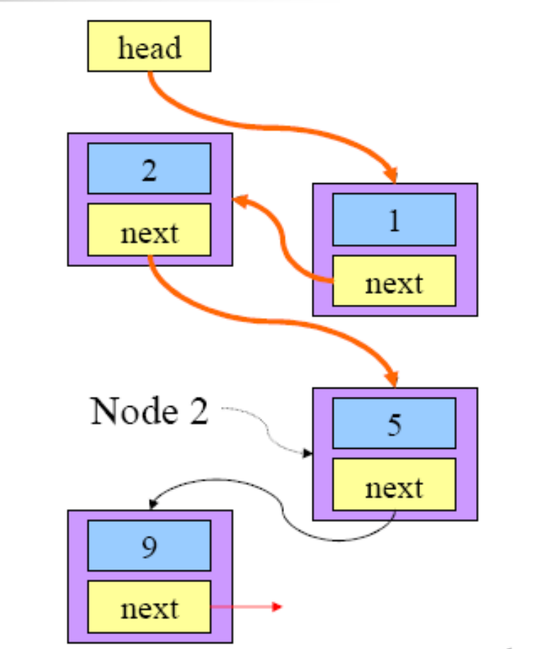
TRAVERSING A LINKED LIST

Slide 69
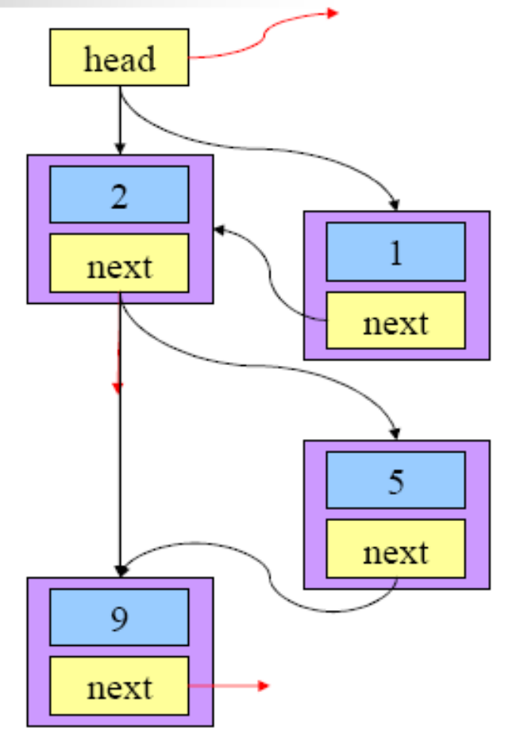
INSERTION IN A LINKED LIST

Slide 70
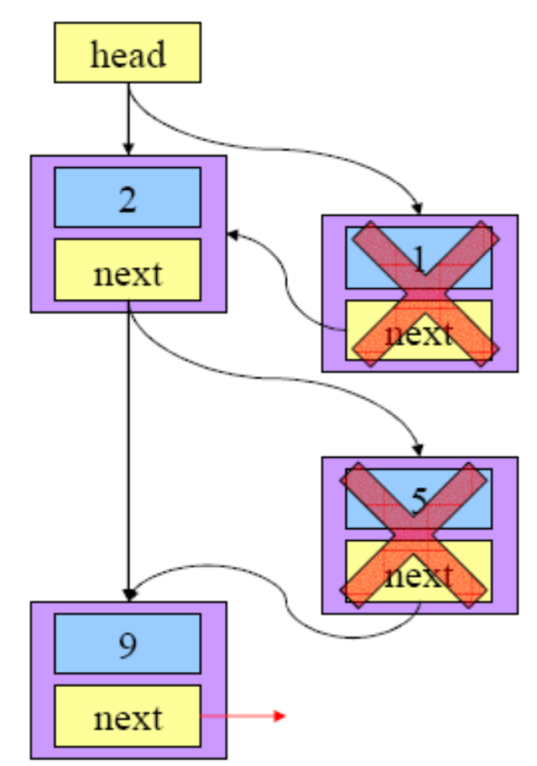
DELETION FROM A LINKED LIST

Slide 71
INTRODUCTION
The singly linked list contains only one pointer field i.e. every node holds an address of next node.
The singly linked list is uni-directional i.e. we can only move from one node to its successor.
This limitation can be overcome by Doubly linked list.

Slide 72
DOUBLY LINKED LIST

Slide 73
DOUBLY LINKED LIST
One in which all nodes are linked together by multiple links which help in accessing both the successor (next) and predecessor (previous) node for any arbitrary node within the list. Every nodes in the doubly linked list has three fields:
LEFTPOINTER, RIGHTPOINTER AND DATA.

Slide 74

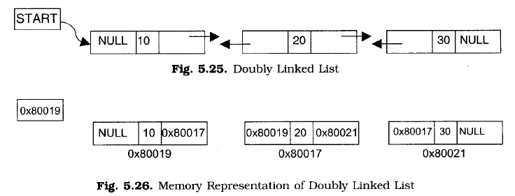
DOUBLY LINKED LIST

Slide 75
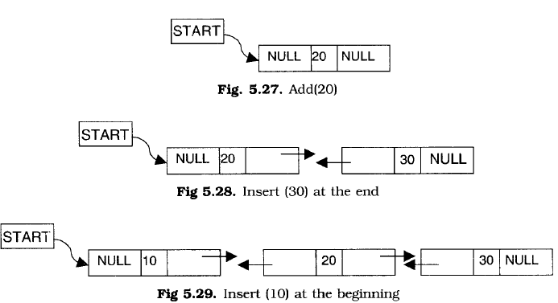
DOUBLY LINKED LIST

Slide 76
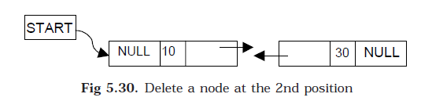
DOUBLY LINKED LIST

Slide 77
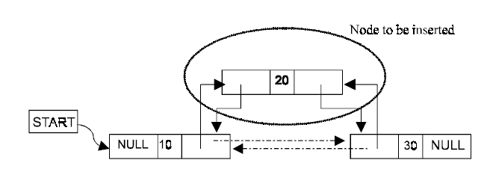
ALGORITHM FOR INSERTING THE NODE

Slide 78
ALGORITHM FOR INSERTING THE NODE
Suppose START is the first position in linked list.
Let DATA be the element to be inserted in the new node.
POS is the position where the NewNode is to be inserted.
TEMP is a temporary pointer to hold the node address.

Slide 79
ALGORITHM FOR INSERTING THE NODE
1. Input the DATA and POS
2. Initialize TEMP = START; i = 0
3. Repeat the step 4 if (i less than POS) and (TEMP is not equal to NULL)
4. TEMP = TEMP → RPoint; i = i +1
5. If (TEMP not equal to NULL) and (i equal to POS)
  (a) Create a New Node
  (b) NewNode → DATA = DATA
  (c) NewNode → RPoint = TEMP → RPoint
  (d) NewNode → LPoint = TEMP
  (e) (TEMP → RPoint) → LPoint = NewNode
  (f ) TEMP → RPoint = New Node
6. Else
(a) Display “Position NOT found”
7. Exit

Slide 80
ALGORITHM FOR DELETING A NODE
1. Input the POS
2. Initialize TEMP = START; i = 0
3. Repeat the step 4 if (i less than POS) and (TEMP is not equal to NULL)
4. TEMP = TEMP → RPoint; i = i +1
5. If (TEMP not equal to NULL) and (i equal to POS)
  (a) Create a New Node
  (b) NewNode → DATA = DATA
  (c) NewNode → RPoint = TEMP → RPoint
  (d) NewNode → LPoint = TEMP
  (e) (TEMP → RPoint) → LPoint = NewNode
  (f ) TEMP → RPoint = New Node
6. Else
(a) Display “Position NOT found”
7. Exit

Slide 81
CIRCULAR LINKED LIST

Slide 82
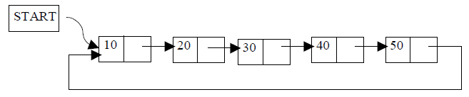
CIRCULAR LINKED LIST
-which has no beginning and no end. A singly linked list can be made a circular linked list by simply storing the address of the very first node in the linked field of the last node.

Slide 83
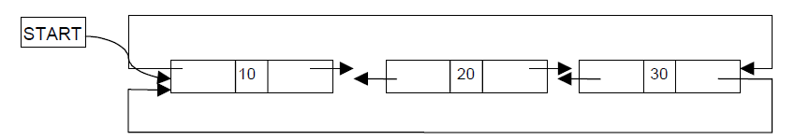
CIRCULAR DOUBLY LINKED LIST
A circular doubly linked list has both the successor pointer and predecessor pointer
in circular manner

Slide 84
DOUBLY LINKED LIST
A doubly linked list is a linked linear data structure, each node of which has one or more data fields but only two link fields termed left link and right link.

Slide 85
DOUBLY LINKED LIST (CONT.)
In Doubly linked list, each node has two pointers.
One pointer to its successor (NULL if there is none) and one pointer to its predecessor (NULL if there is none).
These pointers enable bi-directional traversing.
*Previous
Data
*Next

Slide 86


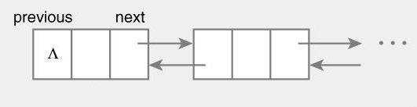

A SINGLY LINKED LIST
Head
A Doubly Linked List
Head

Slide 87
COMPARISON OF LINKED LISTS
Linked list
  struct Node {
    int data;
    Node* next;
  };
Doubly linked list
  struct Node {
    Node *previous;
    int data;
    Node *next;
  };

Slide 88
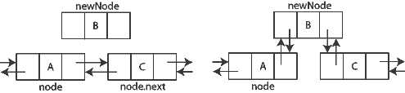
Insertion

Slide 89
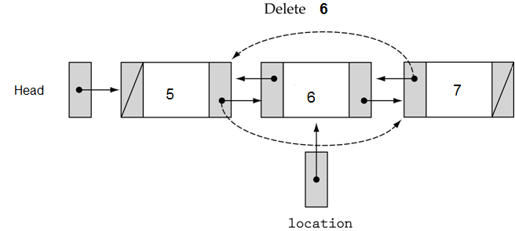
Deletion

Slide 90
ADVANTAGES OF DOUBLY LINKED LIST
The doubly linked list is bi-directional, i.e. it can be traversed in both backward and forward direction.
The operations such as insertion, deletion and searching can be done from both ends.
Predecessor and successor of any element can be searched quickly.

Slide 91
DISADVANTAGES
It consume more memory space.
There is a large pointer adjustment during insertion and deletion of element.
It consumes more time for few basic list operations.

Slide 92
CIRCULAR LINKED LIST
A normal singly linked list has its last node carrying a null pointer.
For further improvement processing one may replace the null pointer in the last node with the address of the first node in the list. Such a list is called as a circularly linked list or a circular linked list or simple a circular list.

Slide 93
ADVANTAGES
The accessibility of a node.
Deletion operations.
The relative efficiency in the implementation of list based operations such as concatenation of two lists, erasing a whole list, splitting a list into parts, and so on.

Slide 94
DISADVANTAGES
The only disadvantage of circularly linked list is that during processing one has to make sure that one does not get into an infinite loop owing to the circular nature of pointers in the list.

Slide 95
CIRCULAR LINKED LIST
A
B
C
Head

Slide 96

CIRCULAR DOUBLY LINKED LIST

Slide 97
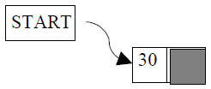
Create a NODE with DATA(30).
Insert a node with DATA(40) at the end
Insert a node with DATA(10) at the beginning
Insert a node with DATA(20) at the 2nd position
Insert a node with DATA(50) at the end
Output -->10, 20, 30, 40, 50
Traversing the nodes from left to right
Delete the 3rd node from the list

